Slide 1
2022 Team Kit Design Instructions
All submissions are due, Sunday, November 7th
This is a pdf of a Powerpoint presentation with templates for the major items. Feel free to use any template you want but bear in mind the individual panels used in each item and the impact on your graphic element.
You can simply print out and hand sketch your graphic ideas, pdf and return to me at: mike.okano1@gmail.com Or, provide me with a hardcopy.
If you have Powerpoint on your computer and would like the original file, please send an email to mike.okano1@gmail.com and I’ll send the original file to you
Feel free to submit in any other graphic software package, but always include a pdf version as I may not be able to open all files.
Color pallet should take into consideration our sponsor logo colors as this cannot be changed.
Please note helmet directions on the following slide

Slide 2
Helmets should be replaced every two years, so our current graphic could be ready for an upgrade as well. However, some have purchased in the past year, so the new kit design should be compatible with this graphic. But feel free to submit a new helmet graphic to match your submission.

Slide 3
Optional
Sponsor Logos
Logo coloration must be as shown.

Slide 4
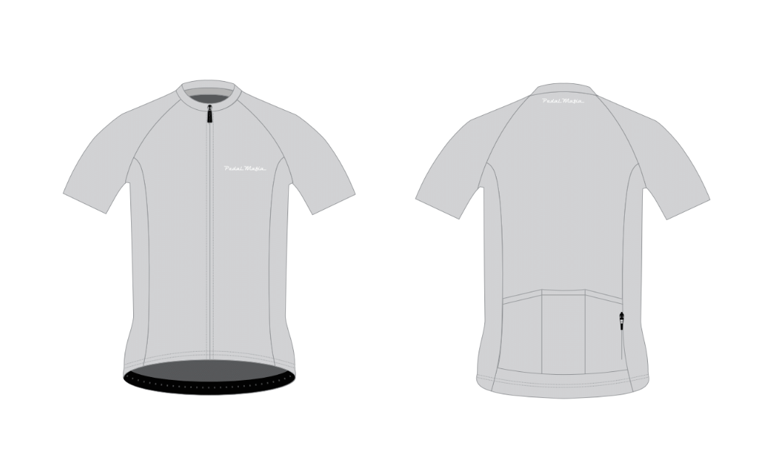

Slide 5
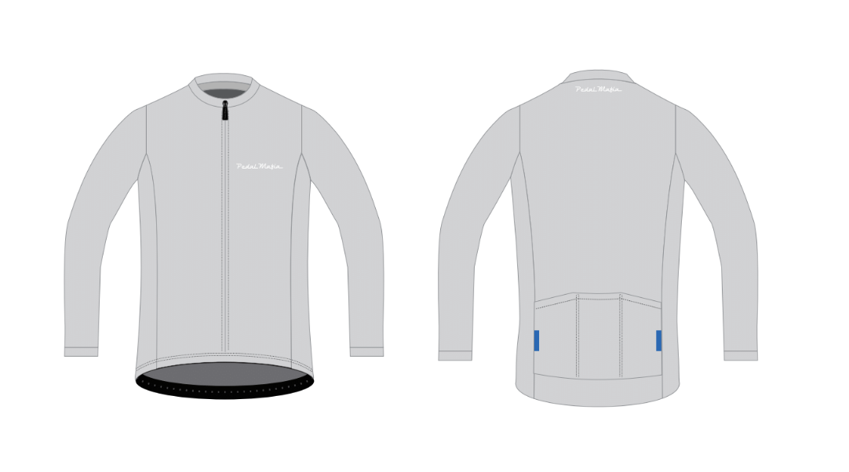

Slide 6
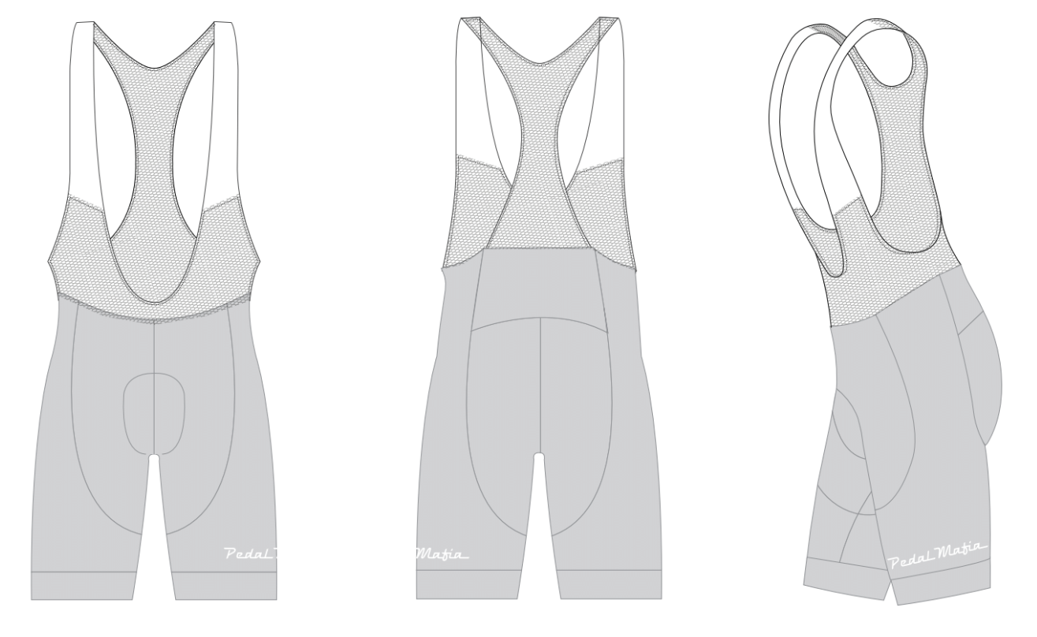

Slide 7
